Slide 1

Information Management
MIS 381N
ONLINE LEARNING BEHAVIOR & PATTERNS
WITH
SNOWFLAKE
Team ANS: Abhiroop Kumar, Nikhil Kumar, Simoni Dalal
UNIVERSITY OF TEXAS AT AUSTIN | MCCOMBS SCHOOL OF BUSINESS

Slide 2

Table of Contents
3) Data Source
4) Bronze Layer
5) Silver Layer
Brief Description
Importing Raw Data
Detail & Data Load
6) STAR Schema
7) Gold Layer
8) Streamlit Dashboard
10) Incremental Loads
Silver Layer Architecture
Answering 3 Questions
Graphs and Visualizations
Before vs After & it’s Effect
12) AI SQL Functions
14) Cortex Search
16) Cortex Analyst
Enriching Data with AI
Using Bronze Layer
Using Silver Layer

Slide 3

Brief Intro About Data
1
Dataset Overview: Kaggle dataset provides metadata on DataCamp courses and learning tracks, useful for analyzing learning patterns, course structures, and optimizing user learning journeys.
2
Main Files:
courses.csv: Core dataset with 23 columns (e.g., title, difficulty, technology, instructors).
all_tracks.csv: Overall info on learning tracks with 18 columns (track title, course count).
3
Mapping Files:
technology_mapping.csv: Maps technology IDs to names.
topic_mapping.csv: Maps topic IDs to subject areas.
3
Notes:
1. Dataset about DataCamp courses and tracks to analyze learning patterns
2. Main Files: COURSES & ALL_TRACKS
3. Mapping Files: TECH_MAPPING & TOPIC_MAPPING

Slide 4

Bronze Layer
Bronze Schema Creation
​
Created a BRONZE schema as the container for raw CSV data, preserving original data format with VARCHAR columns.
Data Loading Infrastructure
​
Established staging area and file format definitions to facilitate CSV file ingestion into the database.
Data Import Execution​
Used COPY INTO commands to load data from staged CSV files into corresponding BRONZE tables efficiently.
Validation & Foundation
Checked for errors, row counts, and column structure to ensure data accuracy for next stages.
4
Notes:
1. BRONZE schema created
2. Internal Stage created for loading CSVs
3. CSV File Format created
4. 4 tables created for the CSVs
5. Executed 4 COPY INTO commands
6. Data validation for accuracy and errors

Slide 5


Silver Layer - Key Steps
Design ERD
Used STAR/Snowflake architecture.
Build Tables
17 tables
[2 Fact, 10 Dimension,
4 Bridge, 1 Audit]
+ 13 sequences
Create Schema
Set up a new SILVER schema.
Populate & Transform
Inserted data using queries and functions (e.g., TO_DATE, TRIM, LOWER).
Validate
Ran checks for clean, accurate data insertion.
Surrogate Keys
Replaced Bronze PKs with SKs for ID differentiation.
5
Notes:
1. ERD architecture design - STAR schema
2. 17 tables: 2 Fact Tables, 10 Dimension Tables, 4 Bridge Tables, and 1 Audit Table
3. 13 sequences for ID columns in Fact and Dimension Tables
4. Surrogate Keys (SK) created to replace raw primary keys from Bronze tables
5. Table data population with complex INSERT queries with data transformations (excluding Audit Table)
6. Data validation to verify clean data insertion into Silver tables

Slide 6
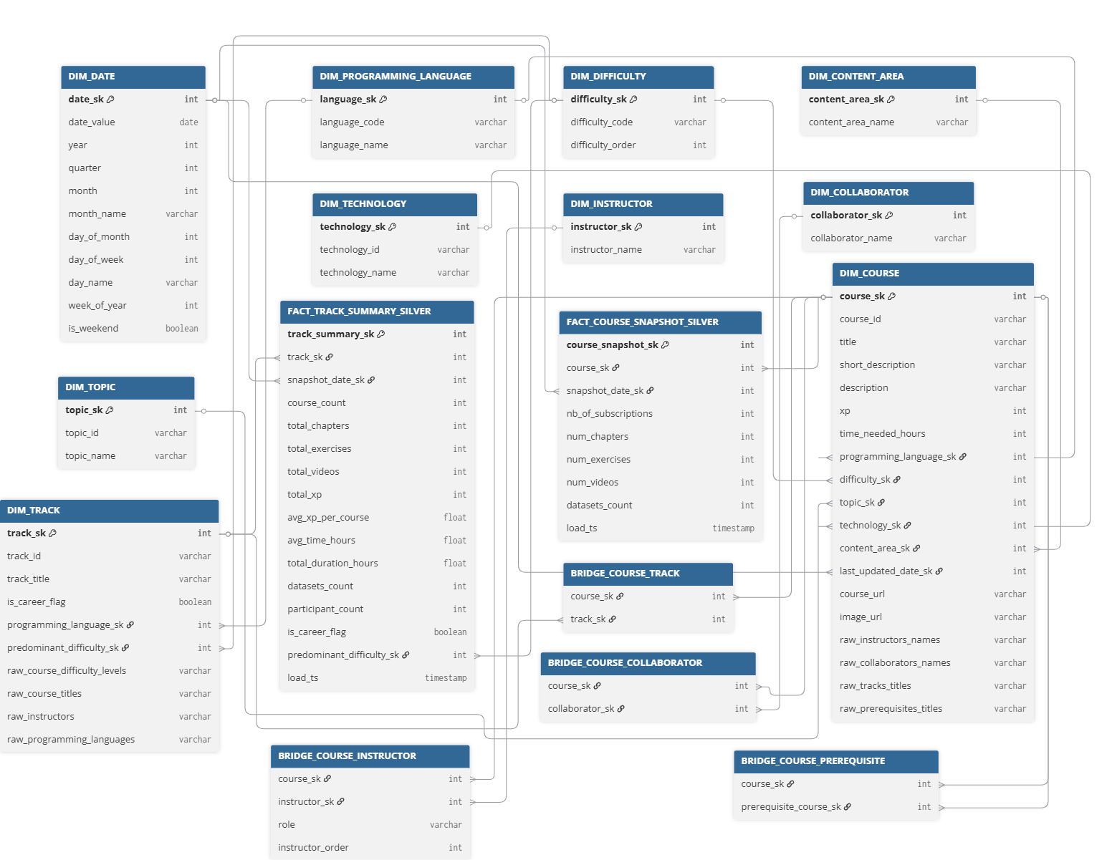
5
STAR Schema - Silver Layer

Slide 7

Gold Layer
Created a new GOLD schema with 3 dynamic tables to answer key business questions, ensuring near real-time data freshness from SILVER. Added an Audit Table for log tracking.
Use Case | Business Question | Required Silver Tables
1 - Programming Language Instructional Effort | Identify which programming languages require the most instructional effort (time, chapters, exercises, videos) across all courses. | FACT_COURSE_SNAPSHOT_SILVER, DIM_PROGRAMMING_LANGUAGE, DIM_DIFFICULTY, DIM_COURSE.
2 - Track-Level Summary | For each career or skill track, calculate total learning content (time, chapters, exercises, videos) and number of courses per track. | BRIDGE_COURSE_TRACK, DIM_TRACK, FACT_COURSE_SNAPSHOT_SILVER, DIM_COURSE.
3 - Course Difficulty Distribution & Curriculum Depth | Analyze course catalog distribution across difficulty levels (Beginner, Intermediate, Advanced) and identify which level contributes the most learning content (chapters, exercises, videos). | FACT_COURSE_SNAPSHOT_SILVER, DIM_COURSE, DIM_DIFFICULTY.
7
Notes:
1. Instructional Effort:
Identify programming languages needing the most instructional effort (time, chapters, exercises, videos).
- Silver tables: FACT_COURSE_SNAPSHOT_SILVER, DIM_PROGRAMMING_LANGUAGE, DIM_DIFFICULTY, DIM_COURSE.
2. Track-level Summary:
Summarize total learning content (time, chapters, exercises, videos) and course count for each career or skill track.
- Silver tables: BRIDGE_COURSE_TRACK, DIM_TRACK, FACT_COURSE_SNAPSHOT_SILVER, DIM_COURSE.
3. Course Difficulty:
Analyze the distribution of courses across difficulty levels and identify which level provides the most learning content.
- Silver tables: FACT_COURSE_SNAPSHOT_SILVER, DIM_COURSE, DIM_DIFFICULTY.
Additionally, it includes tasks to:
- Create a new GOLD schema with three dynamic tables that automatically update from SILVER tables.
- Establish an Audit Table in the GOLD schema for log tracking.

Slide 8

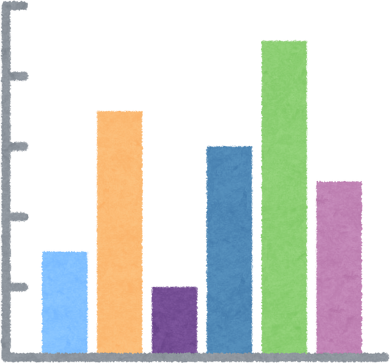

Streamlit Dashboard
Our approach blends strategic insight, creative execution, and data-driven optimization - tailored specifically for growing businesses.
Key Steps
Create a Streamlit python script that visualizes Gold table result-set data
In SnowSQL, create a Streamlit object pointing to the stage & script
Create a new stage in GOLD schema
Upload the Python file to the new stage
The Streamlit dashboard is ready!
Notes:
1. New stage created in Gold schema
2. Python script (with Streamlit library) created for visualizing data from Gold table's result sets in various graphs
3. Python file uploaded to new stage
4. Streamlit Object created (in SnowSQL) referencing the Stage and Python file
5. Open Streamlit Dashboard in Snowflake and view the required graphs

Slide 9
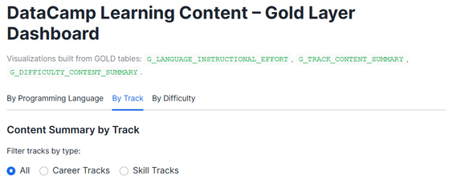
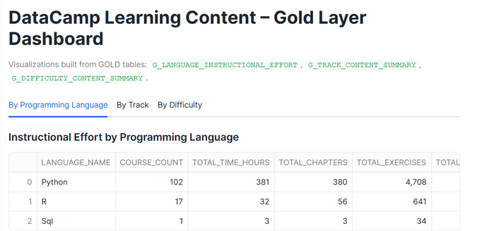
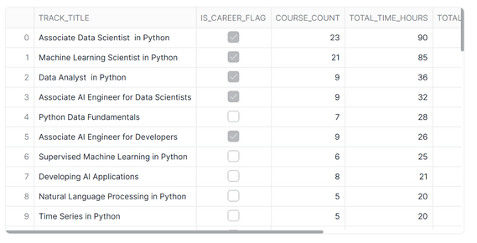
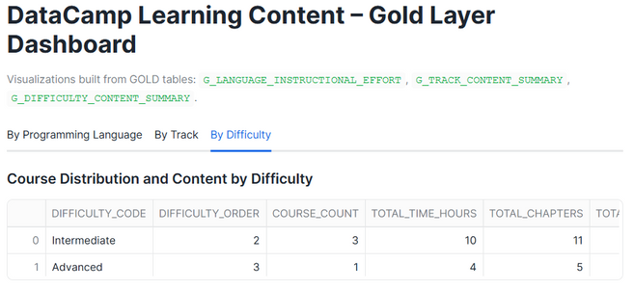
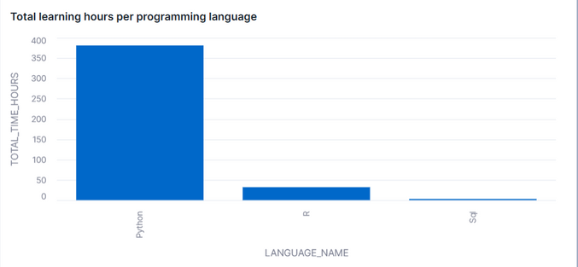
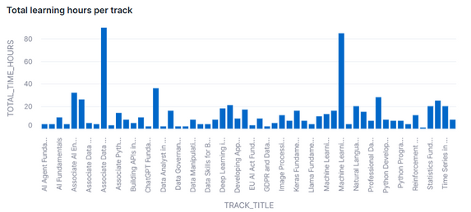
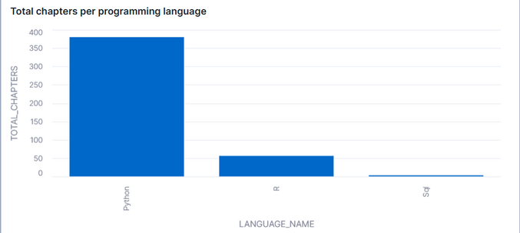
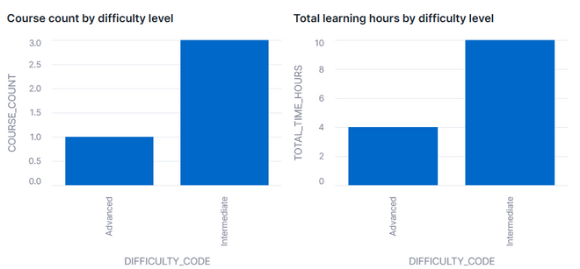
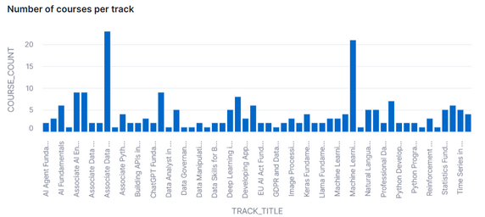
Visualization - 3 Use Cases
By Track
By Programming Language
By Difficulty
Notes:
1. Result Set Tables
2. Bar graph Visualizations

Slide 10
Incremental Load Workflow
Bronze Layer
Create 4 new CSVs
Create New Bronze stage
Create 4 snowpipes
Upload CSVs → Stage
Auto-ingest via Snowpipe
Validate Bronze loads
Gold Layer
No manual step required
Gold dynamic tables auto-refresh
Pre-load validation
Silver & Gold Audit Log SPs
Silver Layer
SP1 → Update BTs
SP2→ Update DTs
SP3→ Update FTs
Wrapper SP → Run all 3
Validate Silver loads
Incremental Data Verification
Call the Audit Log stored procedures again and view the audit tables. Validate the updated count of rows and change in aggregate values across all the tables.
Notes:
1. Before Loading New Data:
- Perform a quick check on Silver & Gold tables
- Create two Stored Procedures to load data into sAT and gAT tables, and view row counts
2. BRONZE Schema:
- Create 4 new CSVs to simulate existing raw CSVs
- Set up a new stage in the BRONZE schema
- Establish 4 Snowpipes for the Bronze tables with the same file format as the initial load
- Load the simulated CSVs into the new BRONZE stage and wait for Snowpipe to auto-ingest the data
- Verify successful import of new data with no duplication or errors
3. Silver Schema:
- Create 3 Stored Procedures to update FTs, DTs, and BTs with complex INSERT queries to ensure data de-duplication
- Create a fourth Stored Procedure to call the first three together
- Execute the fourth stored procedure and verify successful data import
4. Gold Schema:
- No updates needed as GOLD tables are automatically updated after SILVER table updates
5. Incremental Data Verification:
- Call Audit Log stored procedures to validate updated row counts across all tables

Slide 11
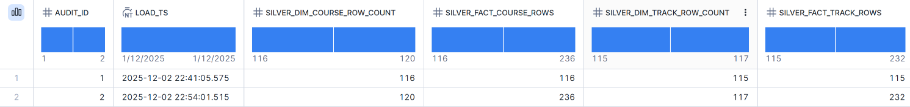
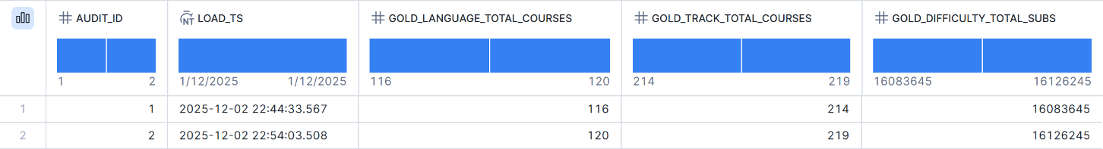
Incremental load
SILVER_LOAD_AUDIT
GOLD_LOAD_AUDIT
11

Slide 12

AI SQL Functions
AI in Snowflake
Use Case 1: AI_COMPLETE
Use Case 2: AI_SIMILARITY
Predicts course title using external LLM
(claude-3-7-sonnet)
Calculates semantic similarity between title and ai_predicted_title
Added column ai_predicted_title, filled via AI_COMPLETE
Added column ai_title_similarity, updated using AI_SIMILARITY
34% of titles have perfect similarity (1.0)
55% ≥ 0.90 → very high accuracy; only 1 value < 0.40
11

Slide 13
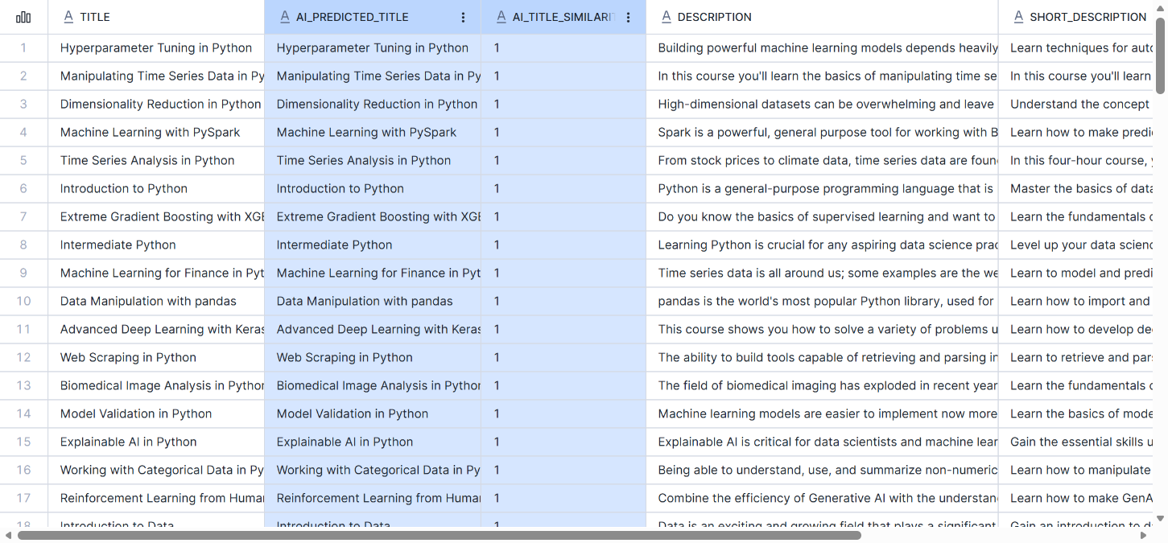
AI SQL Columns - Bronze Layer
DCAMP_COURSES_BRONZE
11

Slide 14






Implementation of Cortex Search
Why: Avoid repetitive SELECT queries for searching relevant details; use Cortex Search for faster, smarter lookups.
Setup: Create 2 Cortex Search Services in BRONZE schema for tables COURSES and ALL_TRACKS.
Search Focus:
Select an appropriate column as the search focus
COURSES
Focus on TITLE column.
ALL_TRACKS
Focus on TRACK_TITLE column.
Search Filters:
Include relevant columns as search filter parameters.
Execution: Run search services for related course/track titles.
Validation: Confirm search results return accurate and relevant values.
11

Slide 15
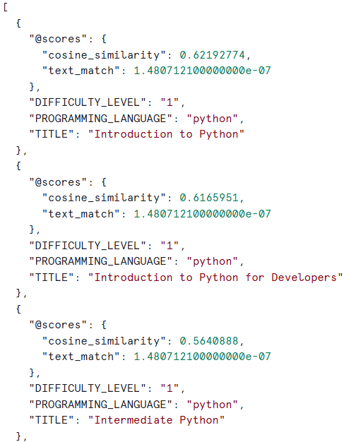
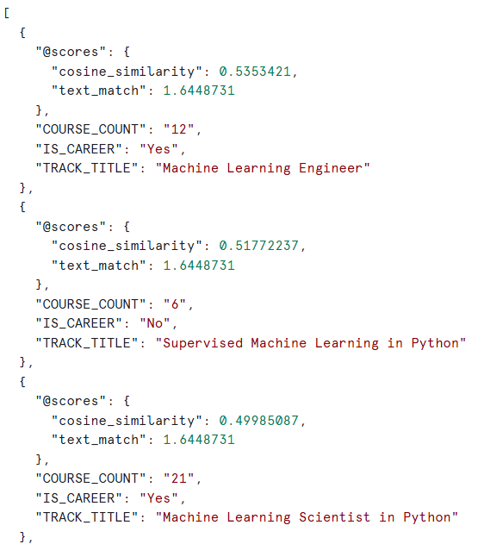
Cortex Search Results
COURSES_CORTEX_SEARCH
TRACKS_CORTEX_SEARCH
“python beginner”
“machine learning”
11

Slide 16
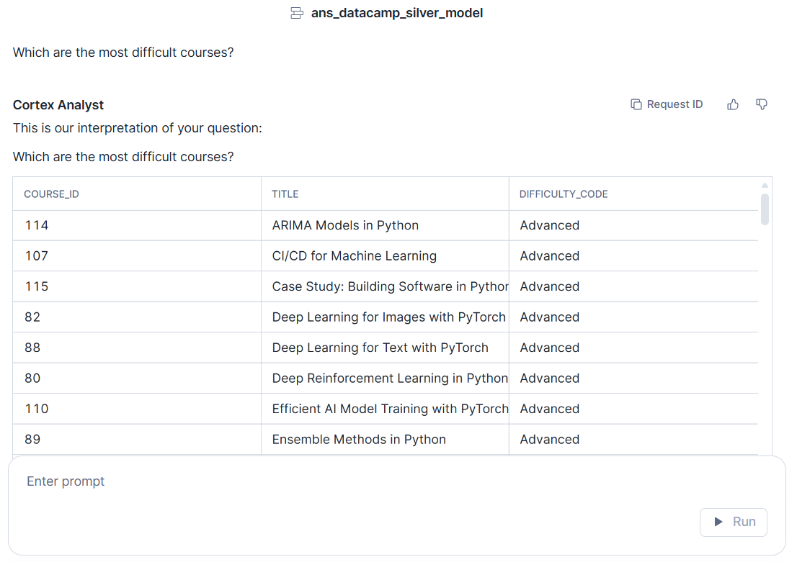

Cortex Analyst - Answer to Complex Queries
Download YAML template
Add silver schema tables + relationships
Upload YAML to stage
Open Cortex Analyst
Select semantic model
Open YAML
Use chatbot to query the data
11

Slide 17



Meet the Team
Abhiroop Kumar
Nikhil Kumar
Simoni Dalal
MSBA’26
9

Slide 18
The End
THANK YOU
DROPPING THE TABLES & SIGNING OFF!

